Slide 1

Apartments analysis
Sara Levi
Stav Elmashally

Slide 2

Introduction and Background
Finding an apartment for rent is not a simple task, And it is usually necessary to see a large number of apartments and be prepared for certain compromises before we can make a decision and enter any apartment.
Our motivation in choosing a project topic in this area comes from the fact that we find ourselves spending a lot of time, each day, for finding apartments for rent.
We decided to take a closer look into Tel Aviv rental market, The most challenging market for finding an apartment for rent. We will try to answer the following questions:
How does the rental prices distribution looks like?
Which are the most expensive areas?
Are we able to predict apartment rental prices?
Are we able to predict the apartment Area?

Slide 3

Data acquisition

Slide 4
How we get the data?
For the purposes of this project, we will use data collected from ads which have been published on the site Yad2.
Yad2 is the leading website for advertising in Israel.
All the information has been collected by us using a Web crawler.
Our data is stored and organized in a csv file.
Tools we used:
Beautifulsoup
Selenium
Requests
Geocode

Slide 5
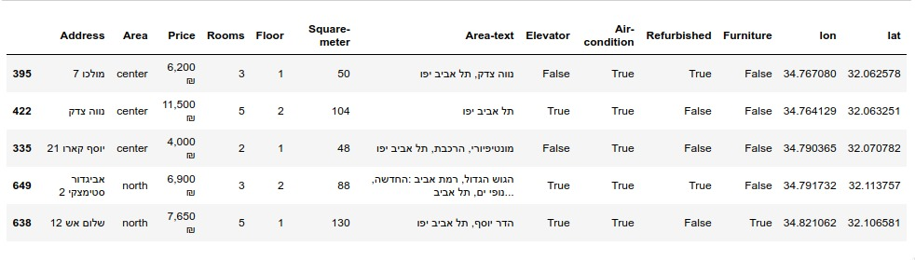
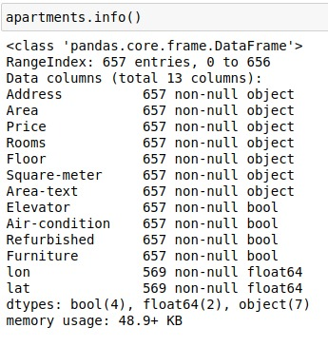
how the data looks like?
We loaded the data into Pandas DataFrame.
The dataset contains 657 records and 13 features before cleaning.

Slide 6
Feature Observation
Address: the actual apartment address
Area: we divided the city into areas (north, south, center)
Area-text: the neighborhood where the apartment is located
Price: price of rent per month in ILS
Rooms: number of rooms in the apartment
Floor: number of floor of the apartment in the building
Square-meter: the size of the apartment space in square meters
Elevator/Air-condition/Refurbished/Furniture: additional parameters that can be exist or not
lon, lat: Longitude and Latitude coordinates

Slide 7

Data Cleaning

Slide 8
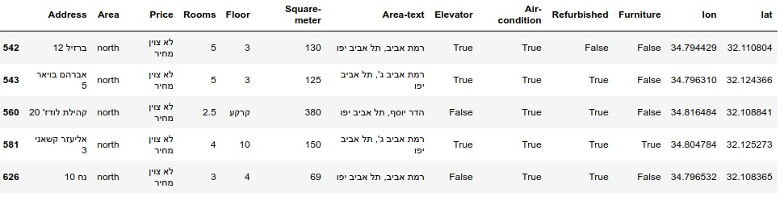
Handling missing data and duplicates
Some of the values such as Price, Rooms and Square-meter are missing and
they anotated as: 'לא צוין’, we decided to delete those records.
Some of the data contains parking and storage for rent, we will filter them by price and square-meter.
We will also delete the duplicated data.

Slide 9
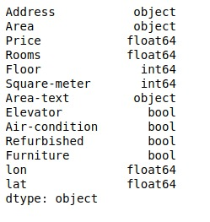
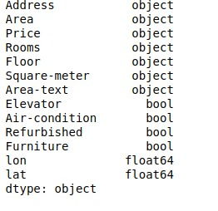
Handling Data Types
some of the values are not in the correct type: Price, Rooms, Floor
so we will need to convert them to the right type.
before
after

Slide 10
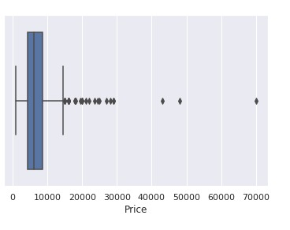
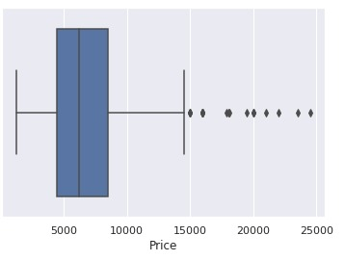
Outliers
We used Box plot In order to find the outliers.
We see that from 25000 the number of apartments is significantly smaller so we will remove those records.
before
after

Slide 11

exploratory data analysis

Slide 12
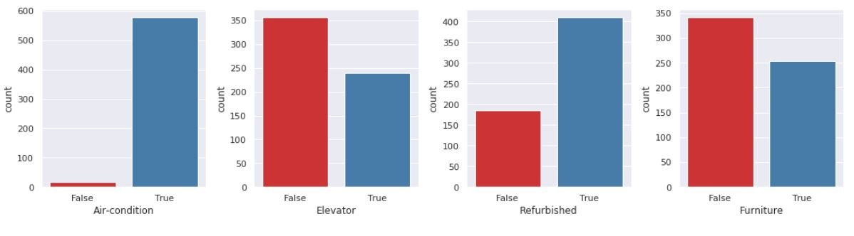
explore some of the features
Elevator, Air-condition, Refurbished, Furniture.
Most of the apartments in Tel Aviv does not have an elevator .
Almost all of the apartments have air condition, still .. this is Tel Aviv.

Slide 13
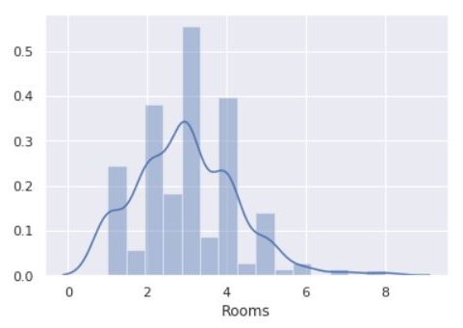
Rooms
The distribution of number of rooms in the apartment.
The number of rooms has an effect on the other features.
Most of the apartments have 3 rooms.

Slide 14
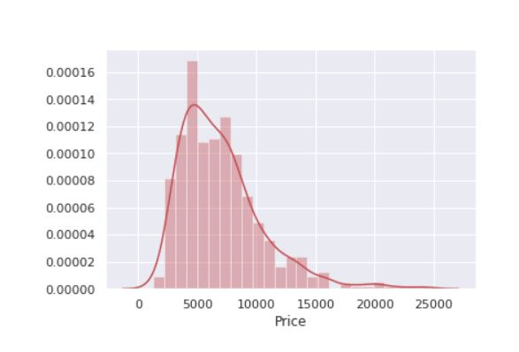
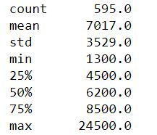
Price
Price is the most important feature in the data set.
This feature played an integral role in some of the other features.
The price distribution having a gaussian shape.
The prices are in ILS (israeli shekels).

Slide 15
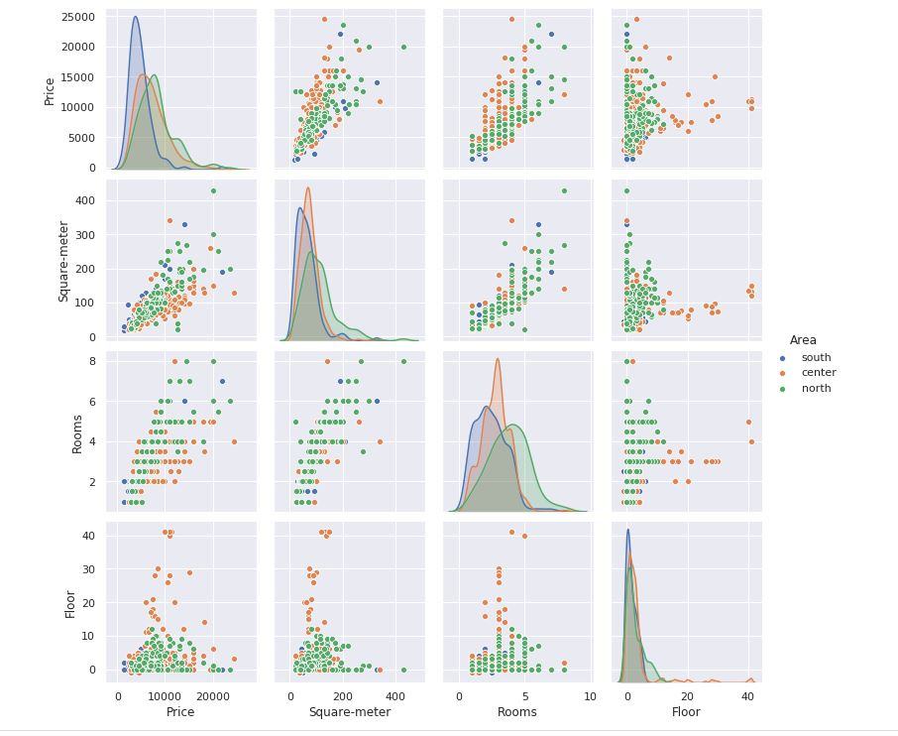
The relationship between the variables

Slide 16
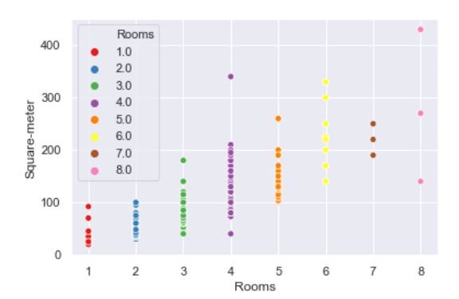
number of rooms VS square-meter
There is a strong relationship between them.
the more rooms the apartment has, the higher the Square meters should be.

Slide 17
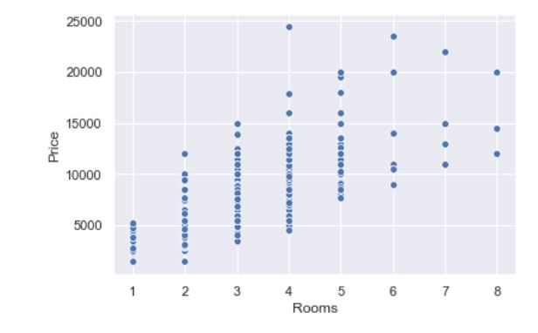
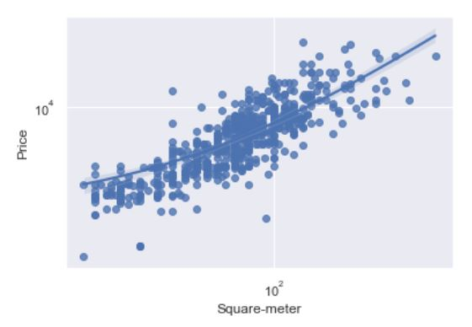
Price vs the other variables
We should also take a look on how the variables in our data relate to apartment prices.
There is a very clear upwards sloping trend relationship between the Square-meter and Price.
The number of rooms plays an important role in the price of the apartment.

Slide 18
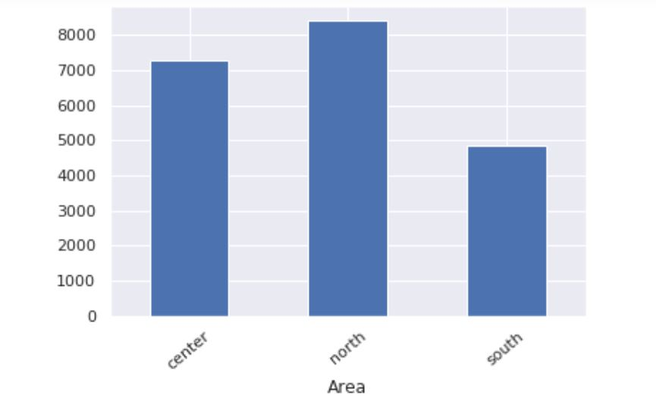
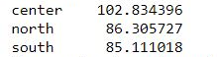
Which are the most expensive areas?
We can see that the center and the north are the most expensive areas.
it is legitimate because they are the hottest areas in the city, and Tel Aviv is a young city and most of the entertainment places are in these areas.
the price for each square meter

Slide 19
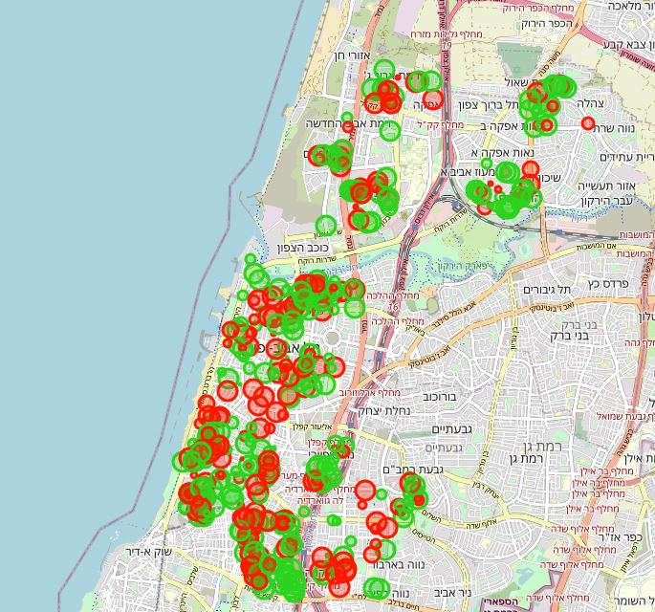
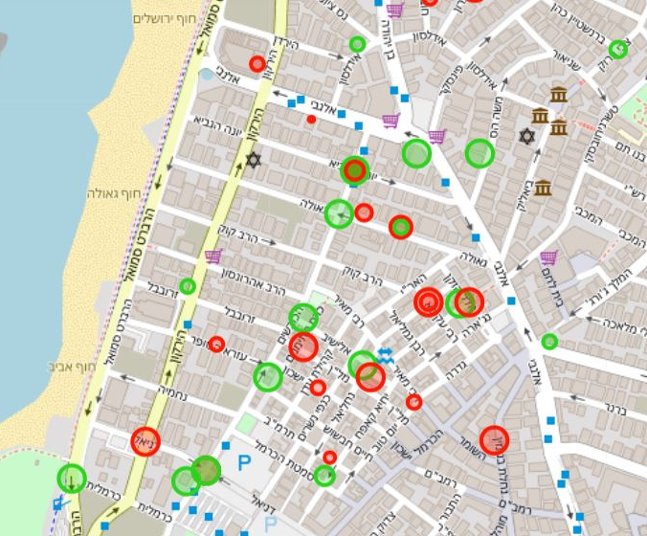
How the data looks geographically?
Red: high price to meter ratio in neighberhood Green: low price to meter ratio in neighberhood
Circle size: according to the apartment size

Slide 20

Machine Learning

Slide 21
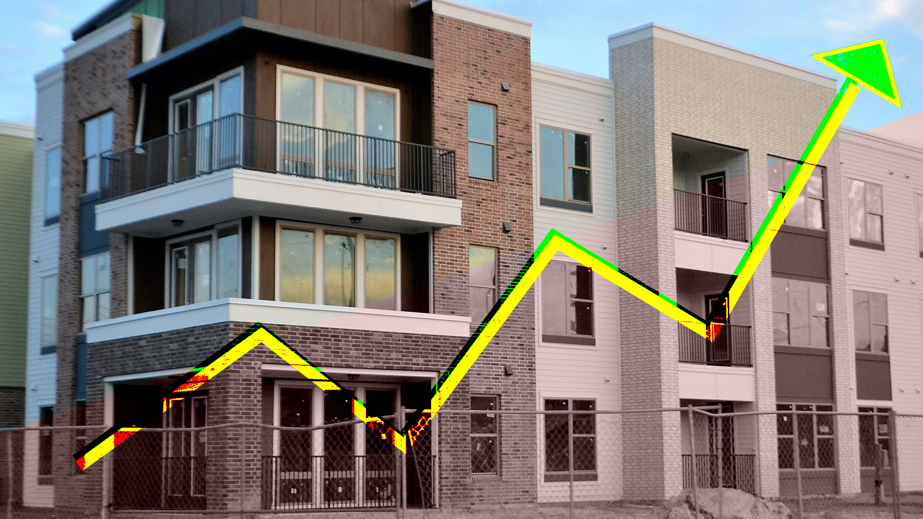
Our goals
Our main goals are:
predict the prices using Regression
predict the apartment area using classification
For this task we will use Scikit-learn.

Slide 22
Preparing the dataset
The model will only take numeric values, and right now we have a few features that are categorical.
The following pre-processing steps were performed on the dataset:
Categorical variables were encoded using One-Hot-Encoding
The dataset was split into training set(80%) and testing set(20%) using Cross-Validation

Slide 23
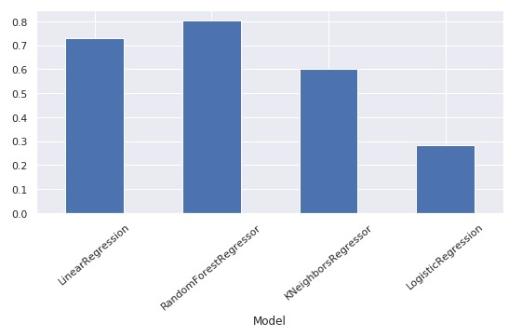
Choosing a regression model
Which has the best prediction accuracy given our data?
We compared 4 Regression models in order to choose the most suitable for this task.
As we can see, the Random Forest showed the best accuracy, so we decided to use this model.

Slide 24
Finding the ideal parameters
We used the tool Randomized Search CV to tests different parameters to maximize the model accuracy.
The results:
n_estimators: 400
max_features: sqrt
min_samples_split: 2
After we found the best parameters,
we were able to achieve 80% accuracy with our model which is quite good.
Training data accuracy:0.9665849
Test data accuracy: 0.8044146

Slide 25
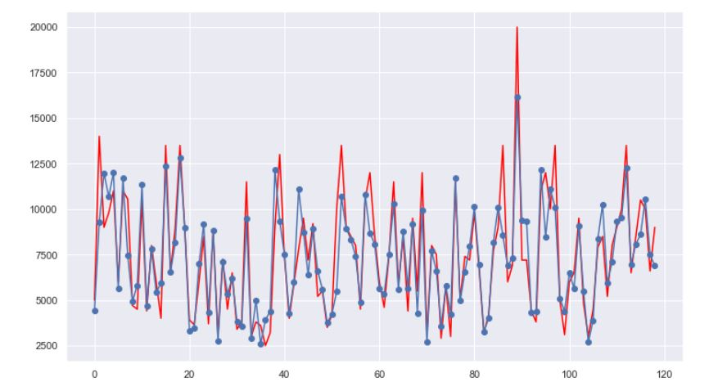
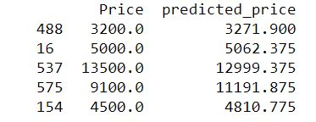
Prediction
After the Training and Testing we are able to achieve:
results
Predicted Values(blue) vs Actual Values(red)

Slide 26
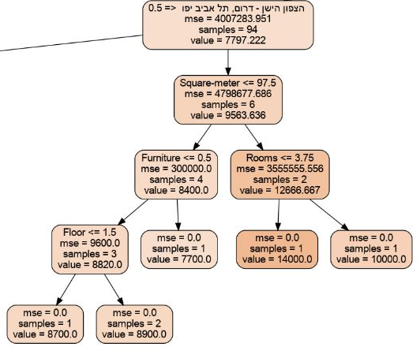
Visualize a Decision Tree
How a single decision tree looks like?

Slide 27
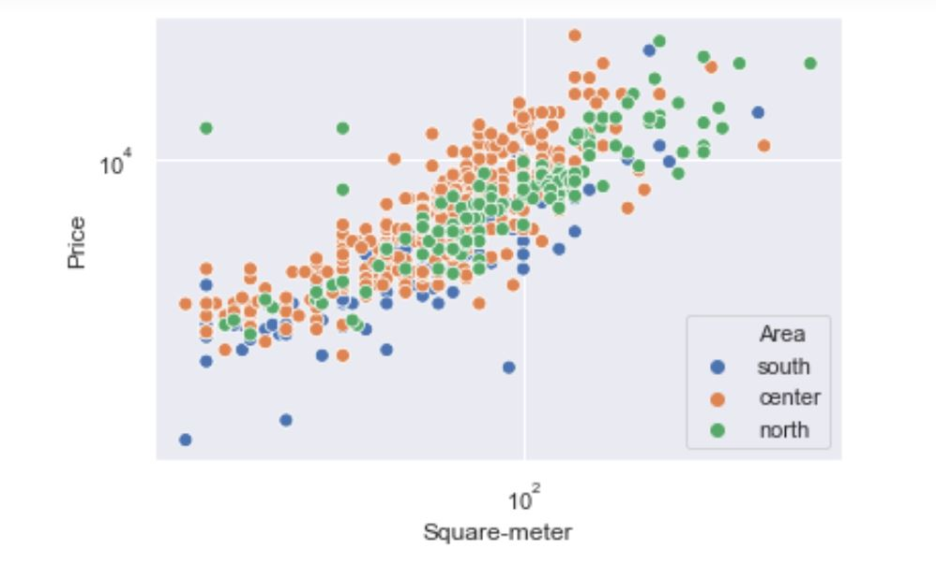
Classification
We will try to predict the apartment area.
Since area is a categorical variable, this is a classification problem.
The distribution between Price and Square-meter according the apartment area
As we can see, there is an understandable division between the area by price and square meter, and yet, we can see that classify the part that is in the center of the graph is very challenging, there are lots of points from different class in the center of the graph.

Slide 28
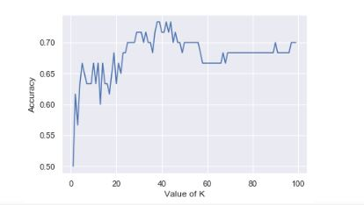
Choosing the best K
which one could give us the best accuracy?
In order To find the best value of K we were able to use plot that shows the relationship between K and the testing accuracy.

Slide 29
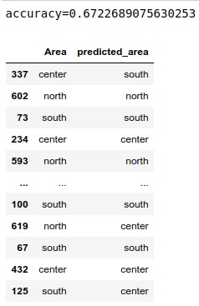
Prediction
After the Training and Testing we are able to achieve:

Slide 30

conclusion
This project helped us a lot in understanding the apartment rental market in Tel Aviv.
We are pleased with the accuracy of the predictions we were able to achieve
Of course, the accuracy of the models can be improved by adding more information and additional features.
In the future, we will expand the scope of this project and add more cities.

